Slide 1
Web Engineering
Lecture 13
HTML Quotations, Comments & Colours
Zulfiqar Ahmad
Lecturer
Department of Information Technology
Hazara University Mansehra
zulfiqarahmad@hu.edu.pk

Slide 2


Slide 3



Slide 4
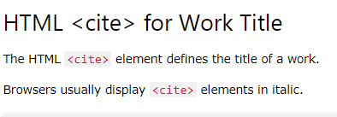
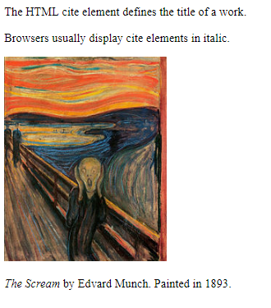
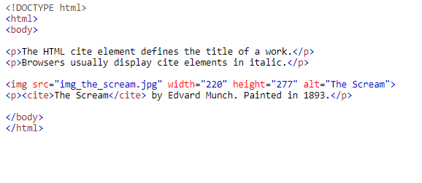

Slide 5

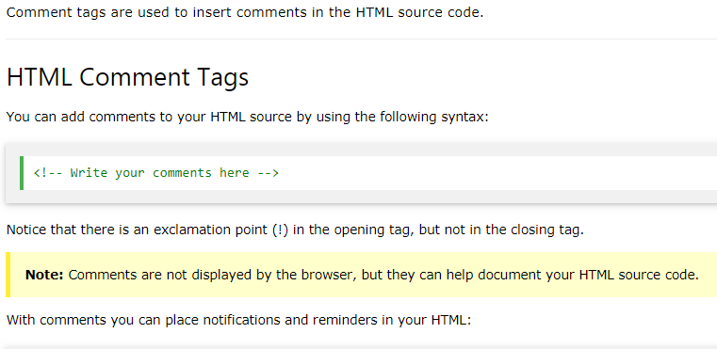
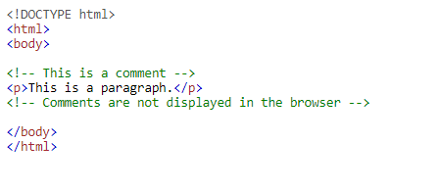


Slide 6



Slide 7

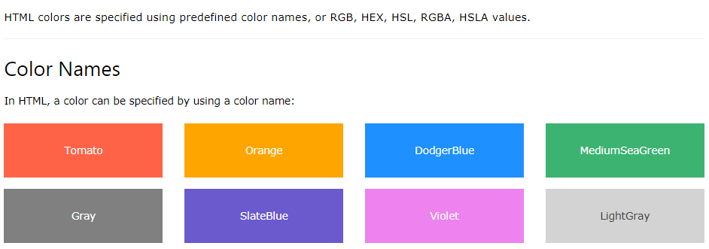

Slide 8
